Slide 1
Relational Database Concepts
Billy Rogers

Slide 2
Basic Concepts
Relational Model (ER diagram)
Entity: a “Thing”
Relationship: a “Connection between Things”

Slide 3
1. Overview: Types of Databases
RDBMS
Transactions
Analytics
Reporting
ANALYTICS
Find & Extract Data
Tidy and make tiny
Validation
Exploratory Analysis

Slide 4
1. Overview : Data Pipeline
Raw Data => Clean
Clean => Tidy Data
Tidy => Analysis
Analysis => Presentation

Slide 5
2. Get Data: Original vs Work Data
Original: Raw Data
Can be messy
Hard to perform analytics
Goal: Handle only once
Work Data: Ready for Analysis
Can be merged, transformed,
aggregated
Notes:
Document
Cleaning behaviors
Bring to court to prosecute fraud

Slide 6
2. Get Data : Provenance
Prove Your Story
Provide to the Client
The raw data
A tidy data set
Define variable/values in tidy data set
Continuous
Ordinal
Categorical
Missing
Censored
An explicit explanation used to go from 1 => 2 & 3

Slide 7
2a. Get Data: Flat File
Google: Baltimore Fixed Speed Cameras
Export
Save to USB and C:\Zooie

Slide 8
2a. Get Data: Load Flat File
Open Excel
File > Open
Delimited
My Data Has Headers
Delimiter = comma
Click Next

Slide 9
2b. Get Data: Database
Download ODBC Driver
Create Windows DSN
Data Source Name
Create Connection
Windows
Oracle
Connect Excel to DSN

Slide 10
2b. Clean Data:
Validation through Formulas
Simple clean up tasks
Capitalization
Spaces
Nonprinting characters
Notes:
XL Connect ⬄ R
XL Connect vignette ⬄ R

Slide 11
Normalization
Normalization: data organized so:
Data addition one place
Data deletion one place
Data modification one place
Other tables know using relations

Slide 12
Normalization
Columns have names (must be unique)
Rows do not
Each column has only one value
Mrs. Emily Tatro
Phone (512) 300-3111; Fax: (512) 300-3222
Column order not important
No two tuples (rows) can be identical
Row order not important

Slide 13
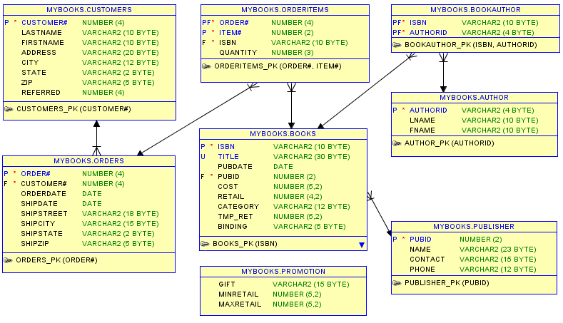

Slide 14
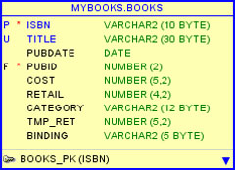
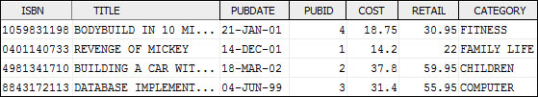
Entity BOOKS (Table)
An Entity in Logical Form
Column Names
Column Data Types
An Entity in Physical Form
Column Names
Column Data

Slide 15
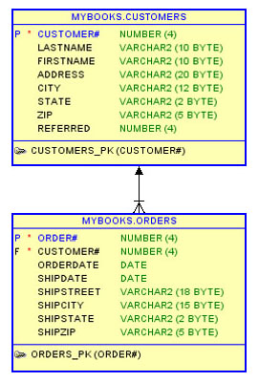
Relationship: Logical
Parent
1. One Parent may have many children
2. Each child must have at least one parent
3. If 2 is not true, then child = orphan
Child

Slide 16
Relationship: Physical
Parent
1. One Parent may have many children
2. Each child must have at least one parent
3. If 2 is not true, then child = orphan
Child

